Slide 1
Red Grouse Ticks
Jia Li Dong, Anthony Roring, Wen Cui

Slide 2
Introduction
Aggregation of parasites
Negative binomial (Poisson-gamma)
Number of Ticks on Grouse Chicks
Poisson-Lognormal distribution
Generalized Linear Mixed Model
No interaction effects
Determined fixed and random effects
Tested variability with 6 different models

Slide 3
Prior Research & Information

Slide 4
So What does prior research tell us?
Model with year, altitude (height), and location effects reduce variance of brood significantly
Variance of chick nested in brood remains the same
Year effect and height effect contributes to most of the variance of brood
Notes:
while none of the variance of chick nested in brood was explained by those two effects.

Slide 5
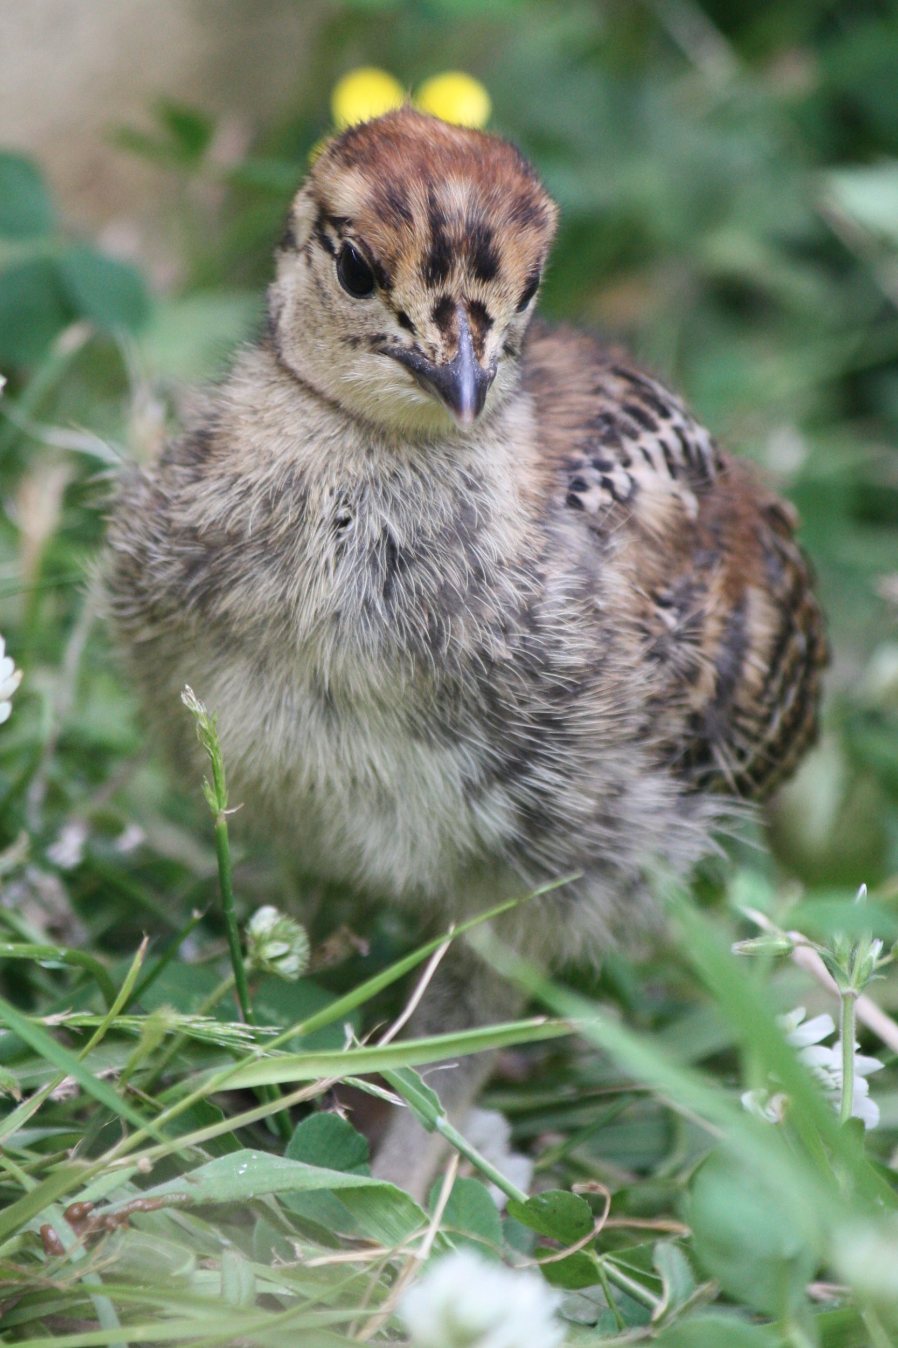
Main takeaway and goals
Evaluate different approaches on grousetick data
Determine significant effects for the number of ticks found on chicks
Tackling the variability on the number of ticks

Slide 6
Exploratory Analysis

Slide 7
Factors and effects determination
Response variable - Ticks
Fixed effects:
Height (Grouped)
Year
Random effects:
Index/Chicks (nested within Brood)
Brood
Location

Slide 8
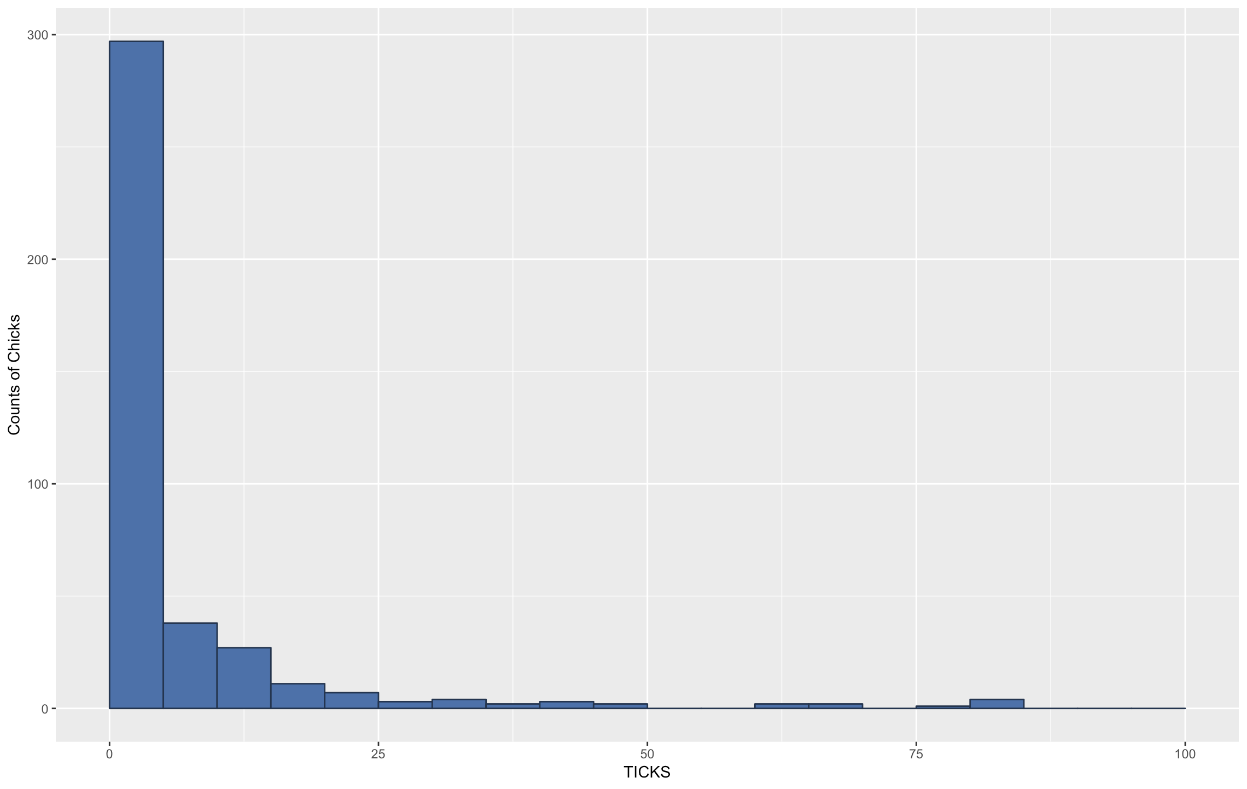
Frequency Histogram of Ticks

Slide 9
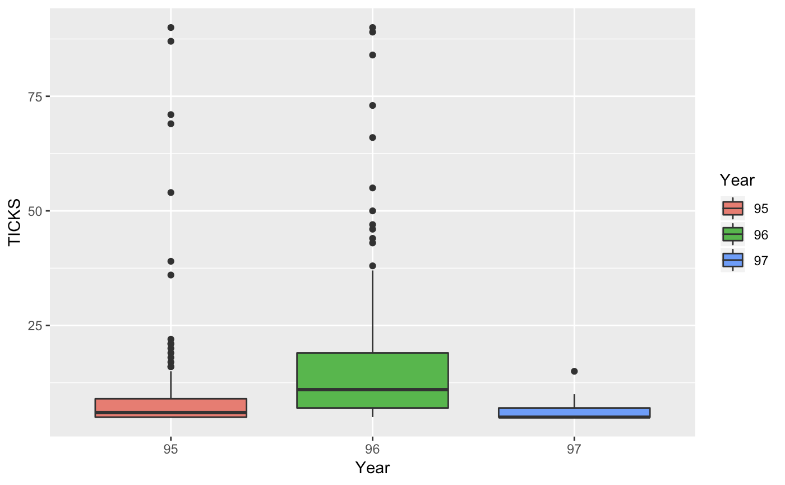
Ticks over the three years

Slide 10
Hypothesis Tests
Fixed effects
Null Hypothesis: Year does not contribute to the number of ticks found in chicks
Alternative Hypothesis: Year is significant to the number of ticks found in chicks
Null Hypothesis: (Grouped) Height do not contribute to the number of ticks found in chicks
Alternative Hypothesis: (Grouped) Height is significant to the number of ticks found in chicks

Slide 11
Hypothesis tests
Random effects
Null Hypothesis: Brood, Chicks, and Location do not contribute to the variance of ticks found in chicks.
Alternative Hypothesis: Brood, Chicks, and Location are significant in terms of the variance of the number of ticks found in chicks are not zero.

Slide 12
Methodology

Slide 13
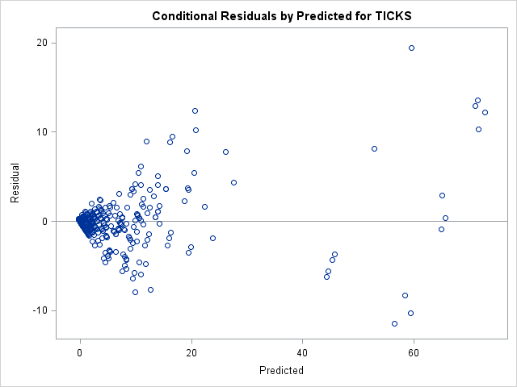
Assumptions & Residual Plot
Errors are independent and normally distributed
mean zero and variance sigma squared
Analysis of residual plot and a Q-Q plot: transformation necessary due to heteroscedasticity

Slide 14
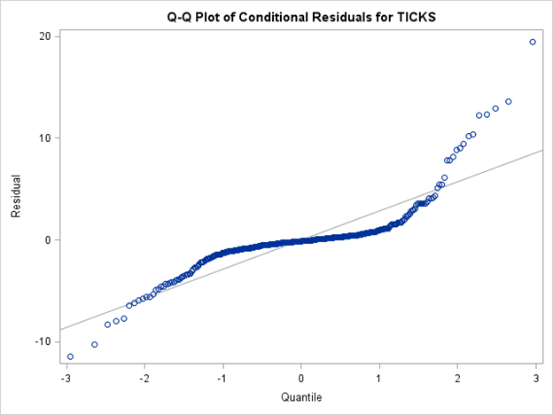
QQ Plot of Data
Data is skewed and does not appear to be normally distributed
Transformation may help to make a normality assumption

Slide 15
How to Transform the Data
Log transformation will help our assumptions to be met
Problem: The number of ticks can be zero
Solution: Shift data by a factor of one, then make the transformation
Variability remains the same
Overall mean will be slightly higher than otherwise would be, but the log mitigates this

Slide 16
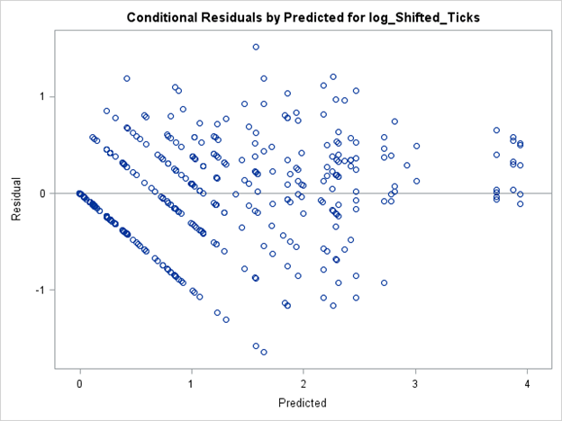
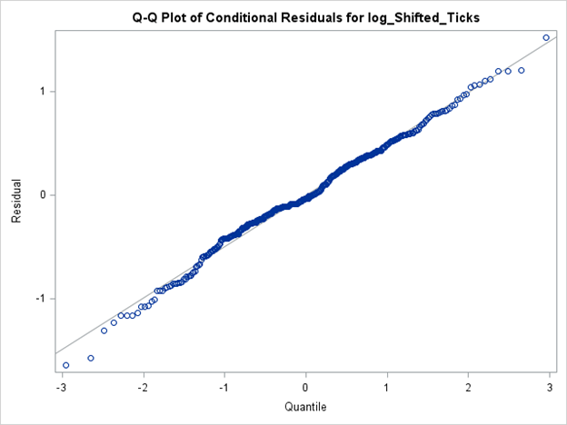
Homoscedasticity (mostly) met; Approximately Normal
Notes:
homoscedasticity

Slide 17
Model Approaches

Slide 18
Interaction of Fixed Effects
Should an interaction of the fixed effects be included?
Tried including it to see whether it was significant
Should an interaction be included?
Effect | Num DF | Den DF | F Value | Pr > F
Grouped Height | 2 | 48.5 | 19.38 | <.0001
Year | 2 | 108 | 24.53 | <.0001
Grouped Height*Year | 4 | 106 | 2.30 | 0.0632

Slide 19
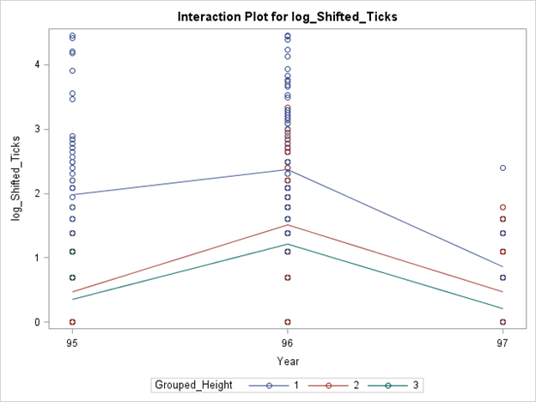
Interaction of Fixed Effects
Notes:
Ultimately decided not to include due to p-value not significant, and this interaction plot.

Slide 20
Interaction of Random Effect
Effect | Estimate | Percent of Variance
Index(Brood) | 0 | 0.00%
Brood | 0.1875 | 25.90%
Location | 0.1458 | 20.10%
Location*Brood | 0.07653 | 10.60%
Residual | 0.314 | 43.40%
Interaction effect accounts for small percentage of variance
Keep the model simple and not include
Notes:
Tried interaction between chick and location - no variability.
Interaction between brood and location had some variability

Slide 21
Grouping Height
Height is a continuous variable, in order to include in model we had to group it into buckets
Grouping considerations:
Keep the height lengths even between groups so as not to introduce bias
Many groups will allow us to pinpoint which height levels play a significant role
Too many groups and we’ll have sparse representation in some groups (fewer chicks sampled from higher elevation)
Grouped Height | Elevation | Frequency
1 | 400-450 m | 171
2 | 450-500 m | 166
3 | 500-550 m | 66

Slide 22
Results

Slide 23
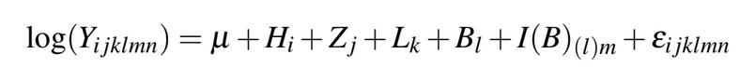
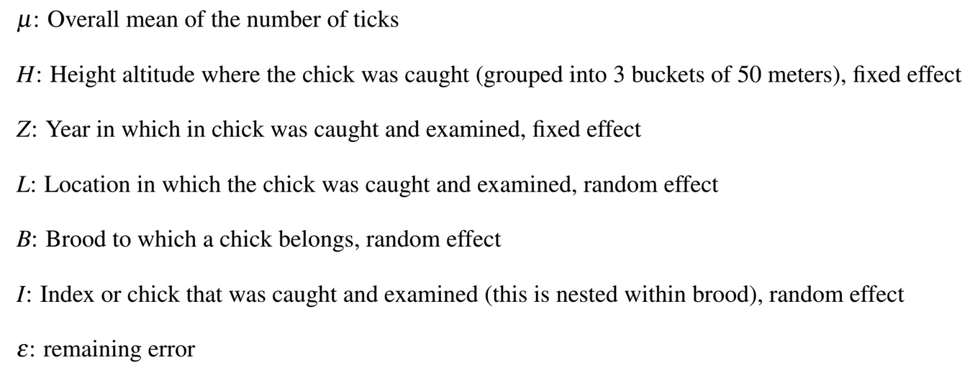
Final Model
Notes:
We used a mixed model with 3 random effects and 2 fixed effect. One random effect, index or chick, was nested within another random effect, brood. The following is the model we used:
log(Y_ijklmn) = Mu + H_i + Z_j +L_k+ B_l + I(B)_(l)m + Epsilon_ijklmn
Where,
Mu: Overall mean of the number of ticks
H: Altitude (Height) where the chick was caught (grouped into 3 buckets of consisting of 50 meters each), fixed effect
Z: Year in which in chick was caught and examined, fixed effect
L: Location in which the chick was caught and examined, random effect
B: Brood to which a chick belongs, random effect
I: Index or chick that was caught and examined (this is nested within brood), random effect
Epsilon: remaining error

Slide 24
Fixed effect
Effect | Grouped Height | Year | Estimate | Standard Error | DF | t Value | Pr > |t|
Grouped Height | 1 |  | 1.7046 | 0.1275 | 49 | 13.37 | <.0001
Grouped Height | 2 |  | 0.7340 | 0.1188 | 51.6 | 6.18 | <.0001
Grouped Height | 3 |  | 0.6286 | 0.1888 | 55.8 | 3.33 | 0.0015
Year |  | 95 | 0.9360 | 0.1272 | 107 | 7.36 | <.0001
Year |  | 96 | 1.7037 | 0.1215 | 104 | 14.02 | <.0001
Year |  | 97 | 0.4276 | 0.1265 | 102 | 3.38 | 0.0010

Slide 25
Differences in fixed effects
Effect | Grouped Height | Year | Grouped Height | Year | Estimate | Std Error | DF | t Value | Pr > |t| | Adjustment | Adj P
Grouped Height | 1 |  | 2 |  | 0.9706 | 0.1747 | 50.3 | 5.56 | <.0001 | Bonferroni | <.0001
Grouped Height | 1 |  | 3 |  | 1.0760 | 0.2281 | 53.8 | 4.72 | <.0001 | Bonferroni | <.0001
Grouped Height | 2 |  | 3 |  | 0.1054 | 0.2230 | 54.6 | 0.47 | 0.6384 | Bonferroni | 1.0000
Year |  | 95 |  | 96 | -0.7677 | 0.1592 | 114 | -4.82 | <.0001 | Bonferroni | <.0001
Year |  | 95 |  | 97 | 0.5084 | 0.1592 | 110 | 3.19 | 0.0018 | Bonferroni | 0.0055
Year |  | 96 |  | 97 | 1.2761 | 0.1562 | 108 | 8.17 | <.0001 | Bonferroni | <.0001

Slide 26
Random Effects
Variable | Estimate | Percent of Variability
Location | 0.1458 | 20.1%
Brood | 0.2641 | 36.5%
Index(Brood) | 0 | 0.0%
Residual | 0.314 | 43.4%
Total | 0.7239 | 100.0%

Slide 27
Conclusions and Discussion

Slide 28
Conclusions
Elston analyze counts in ecology. Uses Poisson-lognormal distribution
We used analysis of variance to test for random and fixed effects
Difficult to compare our model and Elston’s model
Elston’s Model 6 has similarities

Slide 29
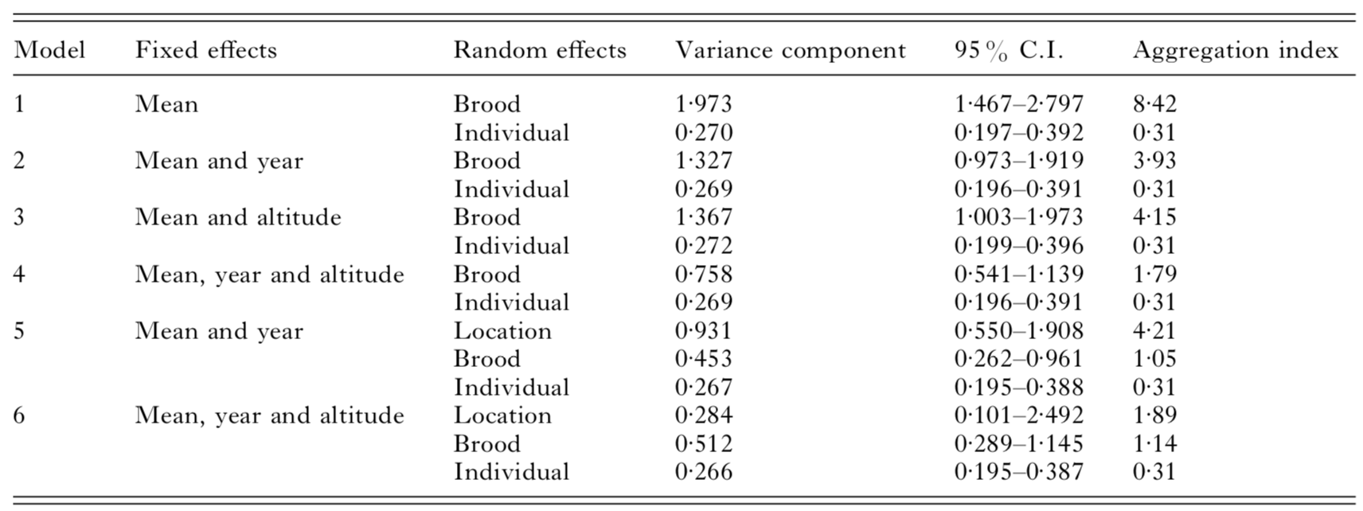
Conclusions
Elston’s Model 6 has similarities

Slide 30
Analysis of final model
Three random effects and two fixed effects
Eliminating irrelevant factors and irrelevant interaction effects
Excluding residuals, brood had the highest contribution in variability
Second highest contribution in variability: Location

Slide 31

Project potentials
Even after a transformation, possible heteroscedasticity present
A non-parametric approach could help solidify our results, or show that perhaps our assumptions were not fully met
Notes:
As far as other changes or conclusions we could come to, we would be interested in taking a non-parametric approach because of its convenience in that we would not have to make any underlying assumptions of normality or homoscedasticity. If we truly felt that the homoscedasticity assumption was not sufficiently met, this would be a good approach to see what conclusions we could come to and whether these conclusions are similar to what we had in our results. If it the conclusions were quite different, it would lead us to believe that perhaps the assumptions we made were just too far off. However, if we came to the same conclusions, it would help support the results of our study and the conclusions we drew.

Slide 32
Questions

